Slide 1
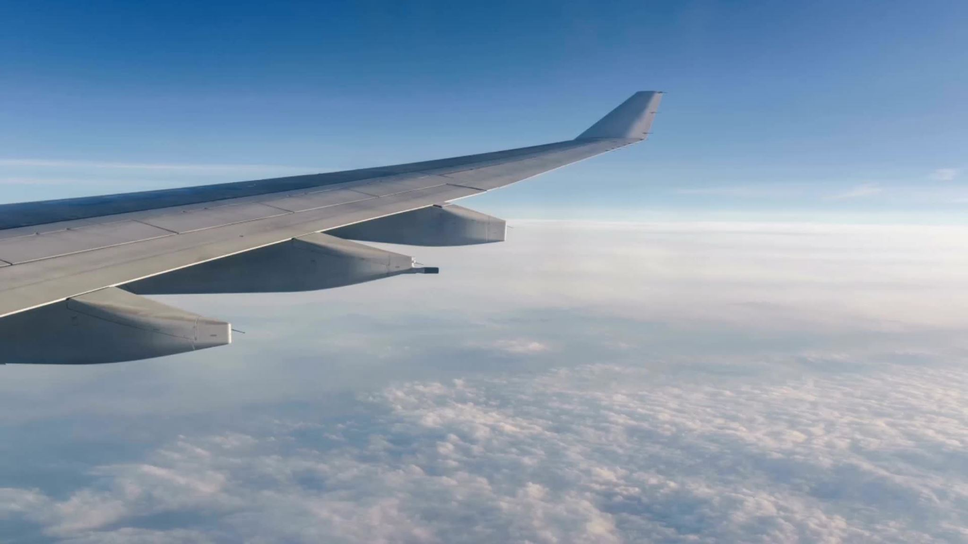
Flight Delays and Cancellations
Team 10
Notes:
Elias

Slide 2
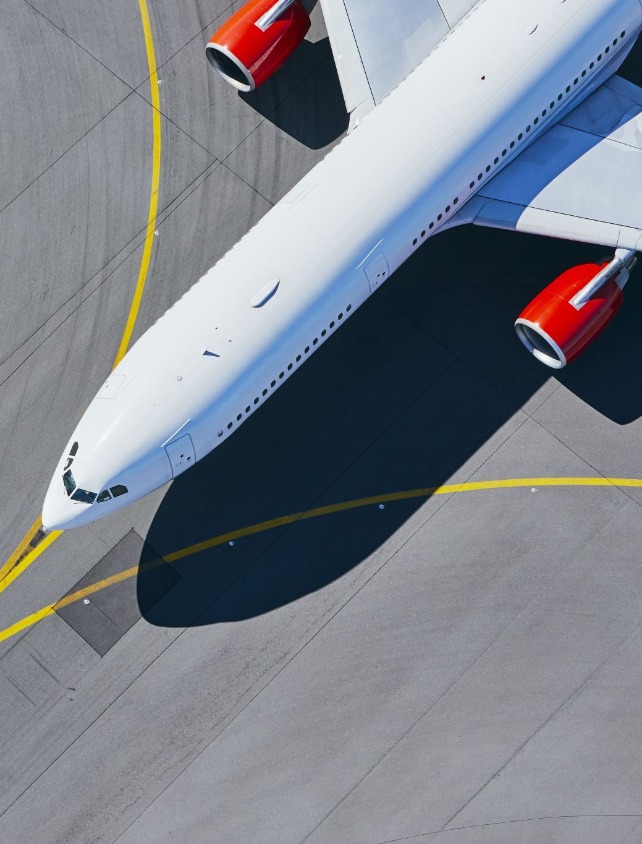
Problem Statement:
- As a travel agency catering to clients with minimal tolerance for delays or cancellations, our goal is to assist them in selecting the most dependable airlines for their journeys.
- We aim to address the question: "Which factors should our clients consider (such as airlines, weather patterns, and airport congestion) to make informed decisions about their airline and airport choices?"
- For example, leveraging our reports, we can advise customers traveling from NYC on selecting the airport with the least congestion and choosing an airline with the lowest likelihood of delays or cancellations.
Notes:
Elias

Slide 3
Data Description
Dataset Overview:
"Airline Delay and Cancellation Data, 2009 – 2018"
Over 750MB of data per year, totaling 7GB
Provides a comprehensive timeline of delays and cancellations worldwide
Data Depth:
Contains over 28 columns
Offers detailed insights into delay causes and patterns
Understanding Delay Causes:
Enables identification of congestion-related delays (e.g., total taxi time)
Facilitates differentiation of weather-related delays (e.g., Weather Description)
Notes:
Samariddin

Slide 4
Big Data Process
Combined 10 years of data into one dataframe using PySpark
Performed transformations on PySpark dataframe to answer key questions
Converted transformed data to Pandas and used Matplotlib to visualize results
Used H2O to perform random forest classifier on data to find significant factors in delays and create a model that can predict delays
Notes:
Samariddin

Slide 5
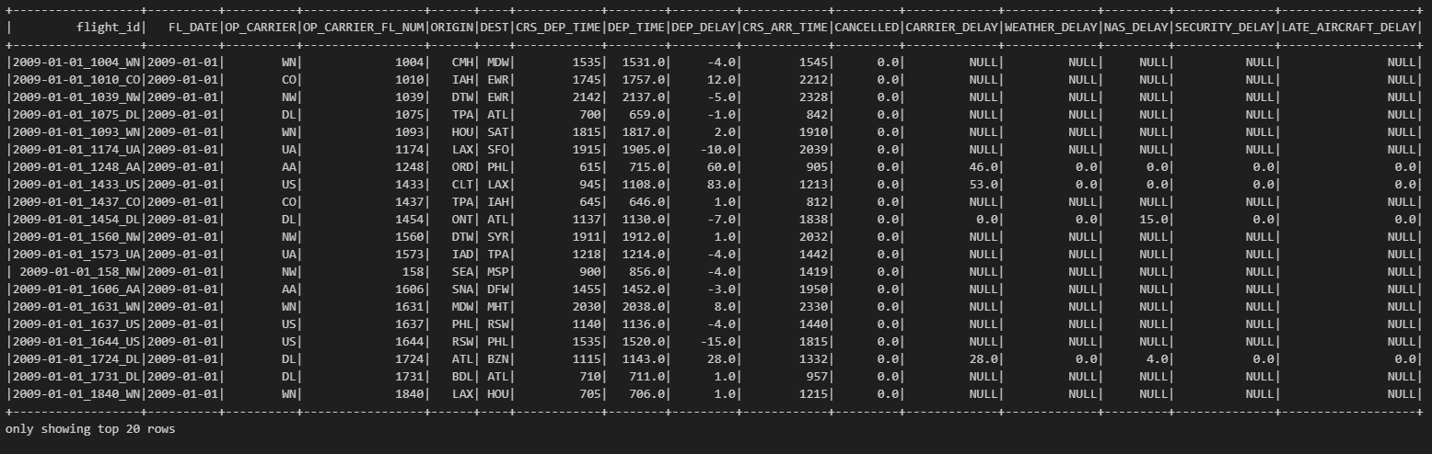
Our Data:
Notes:
Samariddin

Slide 6
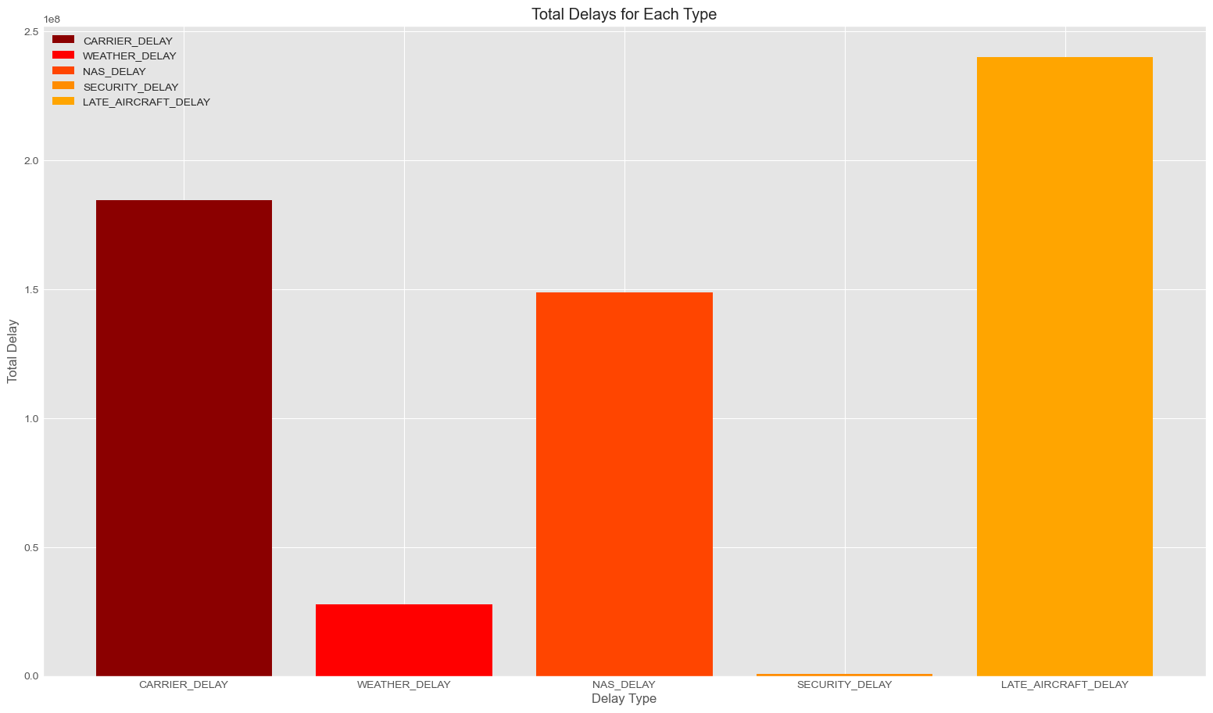
Analyzing Delay Types: Understanding Factors Impacting Air Travel Reliability
This code generates a visualization using matplotlib to illustrate the total delays for different delay types (such as carrier delay, weather delay, etc.).
Notes:
Sofia

Slide 7

Measuring Reliability: Normalizing Delay Metrics by Flight Volume
The code calculates the average delay for each airline by dividing the total departure delay by the number of flights operated by that airline.
By normalizing delay metrics in this manner, we account for differences in flight volume among carriers, providing a fair comparison of reliability.
The resulting visualization illustrates the normalized delay for each airline, aiding in the identification of airlines with consistently lower delays relative to their flight volumes.
Notes:
Sofia

Slide 8
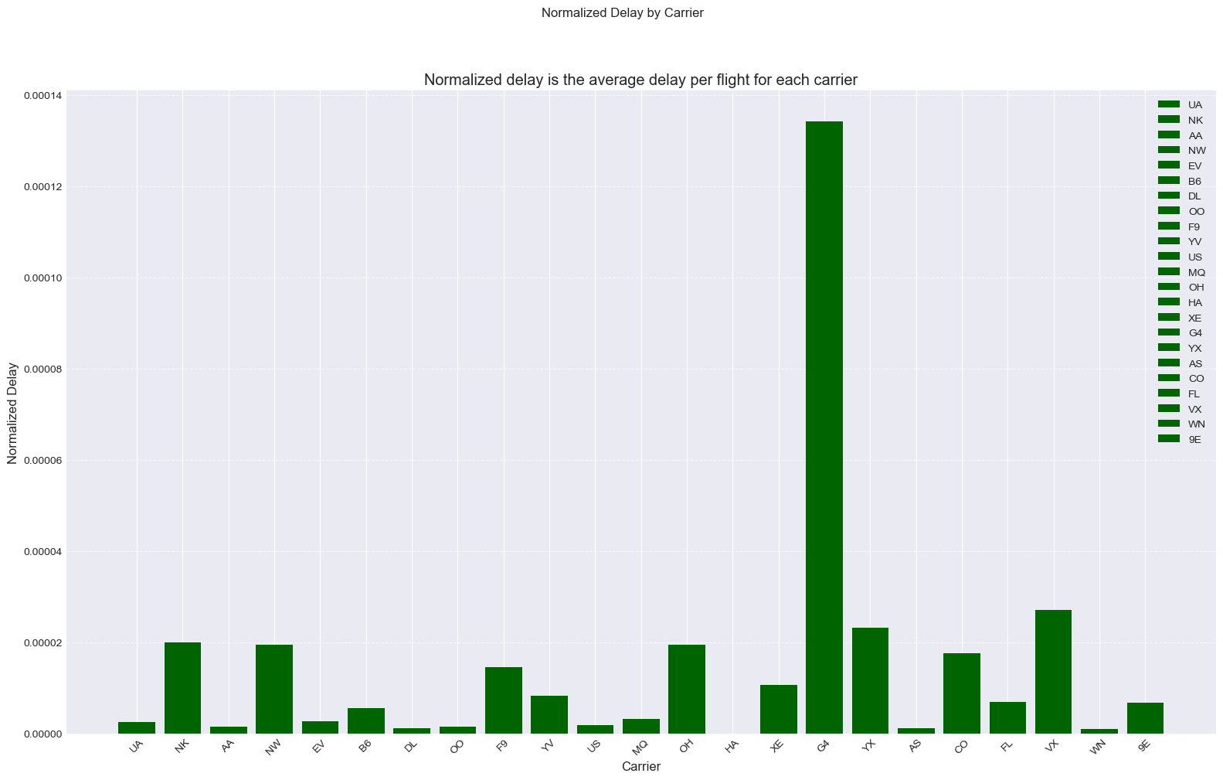
Notes:
Sofia
Allegiant
Virgin atlantic
Republic airways (under united)
Spirit
Northwest airlines (under delta)

Slide 9

Identifying Problematic Routes: Analyzing Average Delays
The code identifies problematic routes by calculating the average departure delay for each origin-destination pair.
By sorting these routes based on average delay in descending order, we can pinpoint routes with the highest delay averages.
The visualization showcases both the normalized delay for carriers and the average delay for each route.
This analysis aids in understanding which routes experience consistently high delays, allowing for informed decision-making when selecting travel routes or airlines.
Notes:
sofia

Slide 10
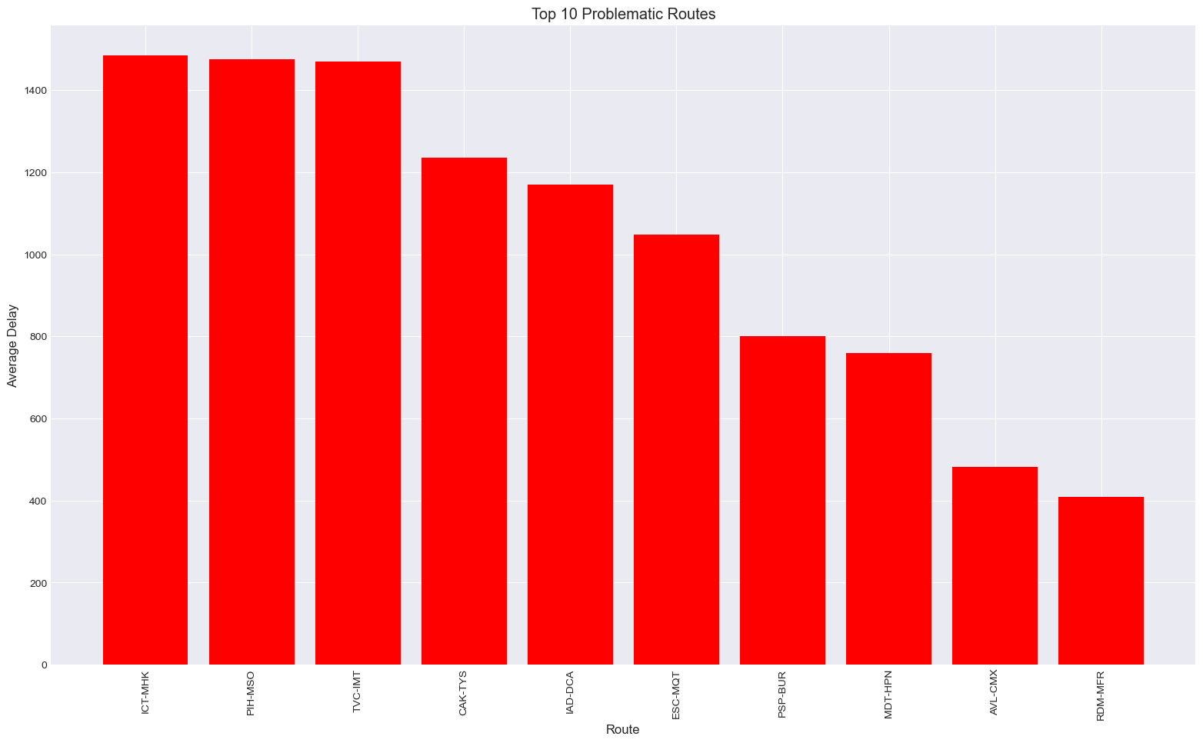
10 Most Problematic Routes
Notes:
Sofia

Slide 11
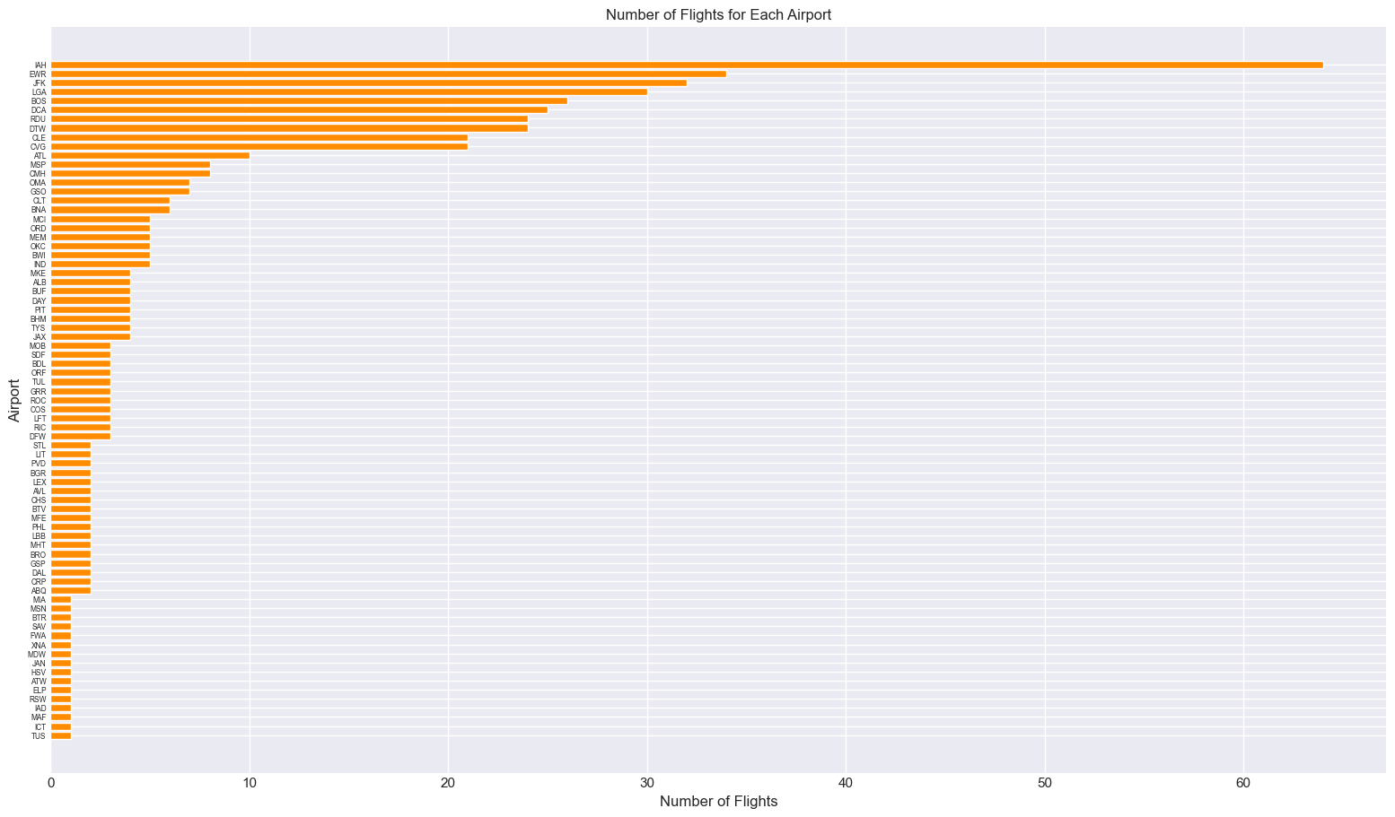
Average number of flights each day per Airport
Notes:
Samariddin

Slide 12
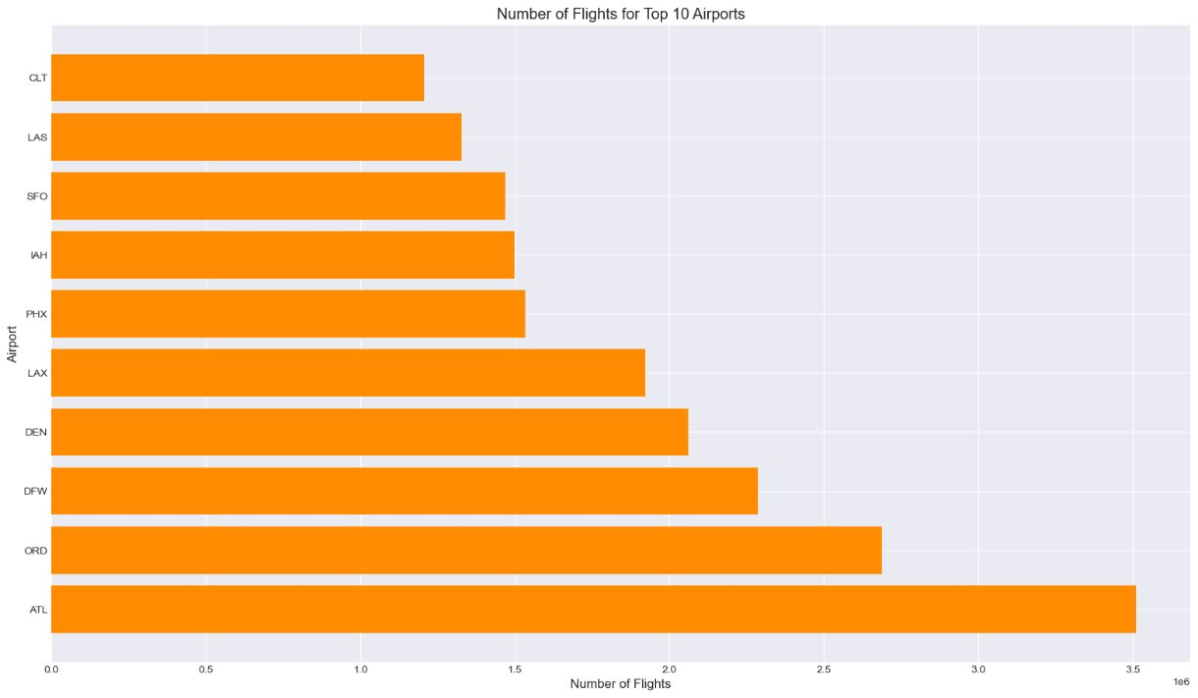
Total Number of Flights (in millions) of top 10 Airports
Notes:
Samariddin

Slide 13
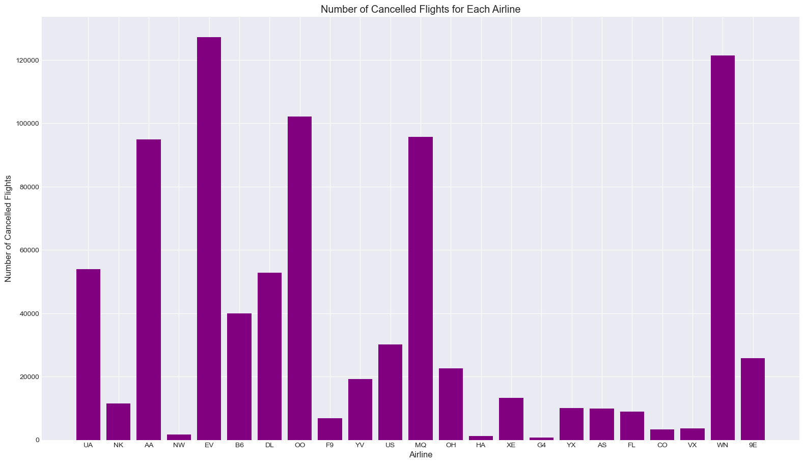
Notes:
Samariddin

Slide 14
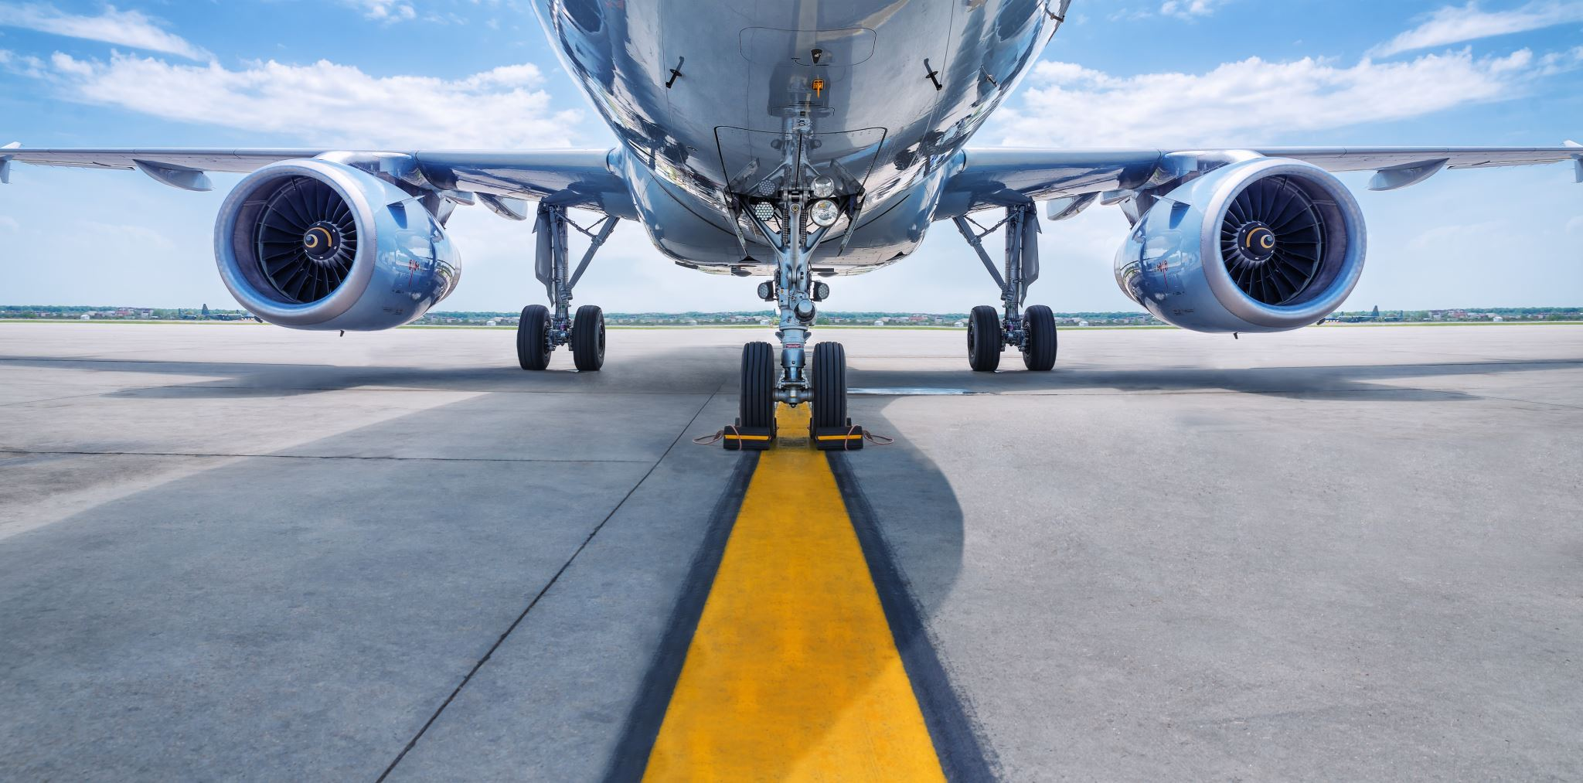
Analyzing Flight Performance: Probability of Delay and Cancellation by Airline
The provided code computes the probability of delay and cancellation for each airline.
It first calculates the total number of flights operated by each airline and the number of delayed and cancelled flights.
By joining these dataframes and computing delay and cancellation probabilities, it offers insights into airline performance.
The resulting visualization presents a comparison of total, delayed, and cancelled flights for each airline, aiding in the evaluation of airline reliability and performance.
Notes:
Elias

Slide 15
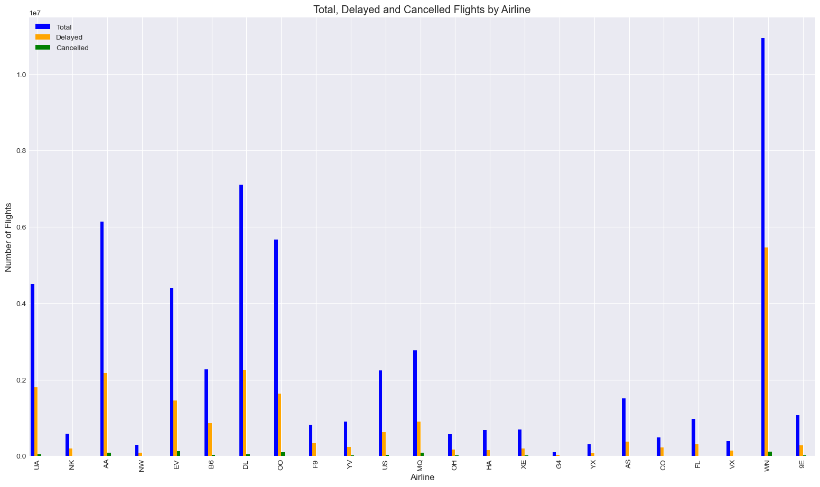
Notes:
Elias

Slide 16
Predictive Analysis: Assessing Flight Delay Using H2O
This code snippet utilizes H2O, a machine learning platform, to predict flight delays.
It begins by initializing H2O and converting the input data from a pandas DataFrame to an H2OFrame.
The predictors and response variables are defined, including features such as total delay, weekend status, and additional categorical variables.
The dataset is split into training and validation sets, and a Random Forest model is trained on the training data.
The model's performance is evaluated using the validation set, providing insights into its accuracy and predictive capabilities.
This analysis facilitates the identification of factors contributing to flight delays and enables proactive measures to mitigate delays in the future.
Notes:
Elias

Slide 17
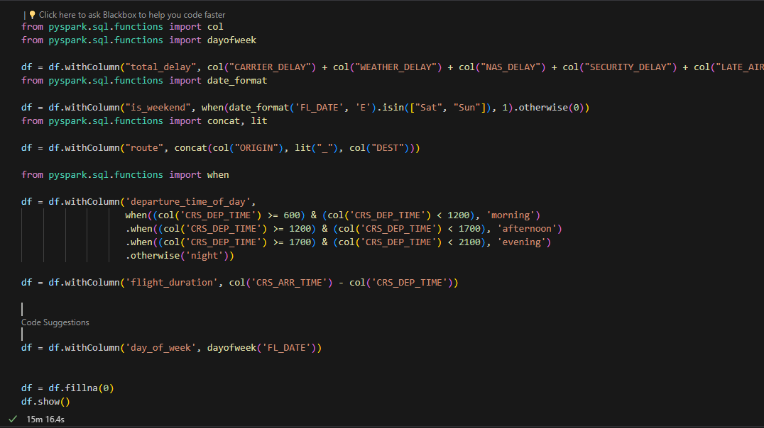
Notes:
Elias

Slide 18
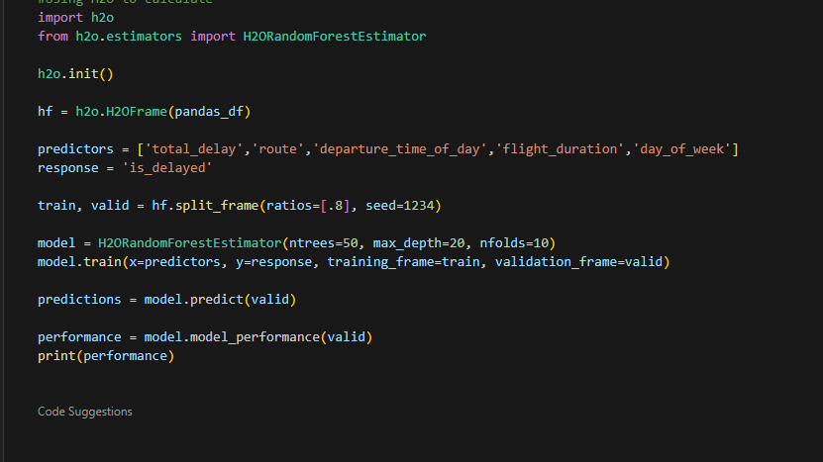
Notes:
Elias

Slide 19
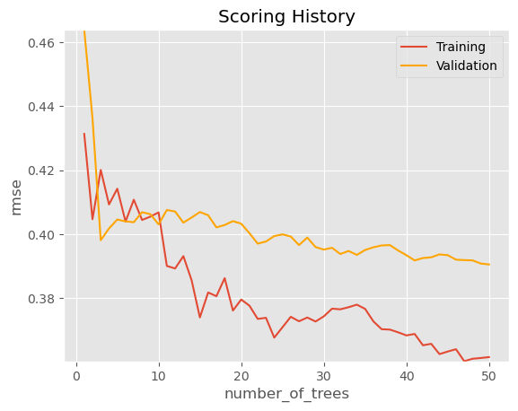
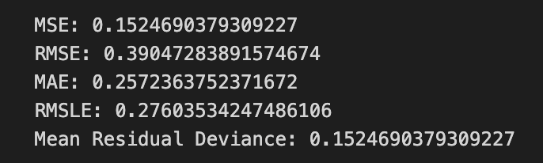
Our Classification Model:
Notes:
Elias

Slide 20
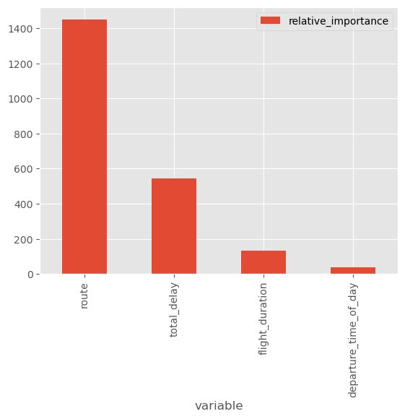
Notes:
Elias

Slide 21
Results
We found out that there are many factors that contribute to delays
Due to the lack of Bias in our data, we were able to find what caused the biggest delays in our classification model, Route
This makes sense as airports like JFK have holding patterns which are caused by congestion.
Potential fixes for our clients include taking off from different airports
Notes:
Elias

